Slide 1

StyleCop Breaking down the barriers to entry
Gary Ewan Park
gep13@gep13.co.uk
Twitter: @gep13
Blog: http://www.gep13.co.uk/blog

Slide 2
Agenda
What is StyleCop?
Visual Studio Integration
MSBuild Integration
Using a Custom Task
StyleCop Compliance
Extending StyleCop
Working with “Legacy” Applications
Additional Tooling Support

Slide 3
Source Code
http://gep13.me/StyleCopDemos
Notes:
Questions – feel free to ask them at any point, just throw up your hand, or if I don’t see you, feel free to shout at me.
Explain what I have on my machine, i.e. all code in Local Git Repo, Git Extensions in Visual Studio, TeamCity, local Nuget Repo for a couple packages
Make sure to explain that the intention of the talk is to show how, out of the box, StyleCop can appear to be slightly “jarring”. However, there are processes and tooling that you can add/implemented that can make things easier.

Slide 4
What is StyleCop?

Slide 5
A Definition…
“StyleCop is an open source static code analysis tool from Microsoft that checks C# code for conformance to StyleCop's recommended coding styles and a subset of Microsoft's .NET Framework Design Guidelines. StyleCop analyzes the source code, allowing it to enforce a different set of rules from FxCop.” *
Reference
http://stylecop.codeplex.com/
* http://en.wikipedia.org/wiki/StyleCop
Notes:
Ask who is currently using StyleCop
Ask who is currently using FxCop – Code Analysis
Coding Standard ARE NOT the personal preference of the most senior person on the team!

Slide 6
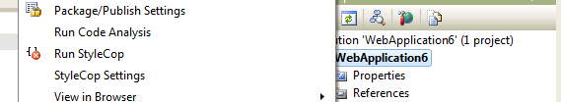
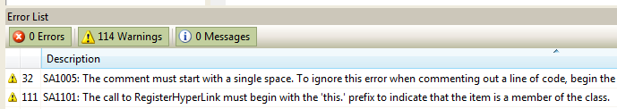
What does that mean?
StyleCop is a “plugin” for Visual Studio 2008, 2010, and VS 11 Preview (and in a way, 2005* and Express)
It provides 162 rules over 7 categories of “style”
* http://gep13.me/ie1T0V
Notes:
The rules are classified into the following categories:
- Documentation
- Layout
- Maintainability
- Naming
- Ordering
- Readability
- Spacing
StyleCop includes both GUI and command line versions of the tool. It is possible to create new rules to be used.
StyleCop was re-released as an open source project in April of 2010, at http://stylecop.codeplex.com.
Originally used internally within Microsoft, and later released to the public.

Slide 7
Visual Studio Integration

Slide 8
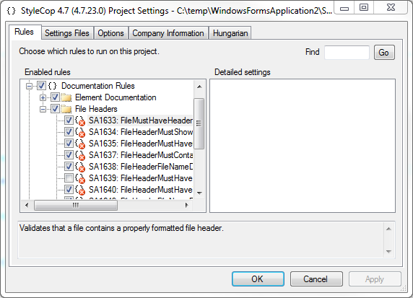
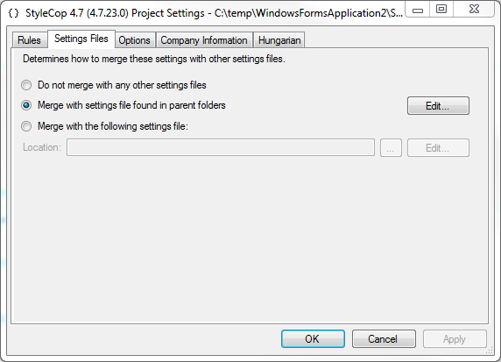
Visual Studio Integration
Notes:
StyleCop Analysis at:
- Solution Level
- Project Level
- Code File Level
Turn On and Off Rules
Configure Settings
Override Default Hungarian Notation
Specify Company Information

Slide 9
Demo 1
Visual Studio Integration
Using StyleCop on a New Project

Slide 10
MSBuild Integration

Slide 11
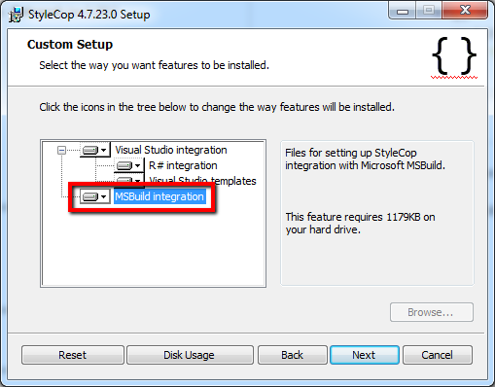
This gets installed by default…
During the installation
you have the option
to install MSBuild files. These files will be required if you want to integrate StyleCop analysis with the Visual Studio build process or a Continuous Integration Server.
Notes:
Mention that this isn’t “required” if you use the StyleCop Nuget Package

Slide 12

MSBuild Integration – Visual Studio
To add StyleCop as part of the “Build” process in Visual Studio follow these steps:
Use the StyleCop.MSBuild Nuget package to install the necessary files and make file edits.
This edits the project file to include:
Add the following property in the project file to force all warnings to be treated as errors:
Notes:
The MSBuild files that are installed as part of the StyleCop installation are not actually required if you use the Nuget Package.

Slide 13
Demo 2
MSBuild Integration
Including StyleCop Analysis as part of the Build Process

Slide 14
Using a Custom Task

Slide 15
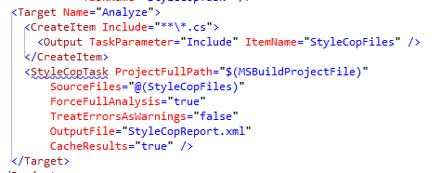
MSBuild Integration – Custom Task
StyleCop also includes a MSBuild task that can be used to create a custom build step
Manning Publications – Continuous Integration in .NET
http://gep13.me/MuNEL9

Slide 16
Demo 3
Using a Custom Task
Running StyleCop Analysis as a custom task with MSBuild and TeamCity
Notes:
C:\Program Files (x86)\MSBuild\Microsoft\StyleCop\v4.4

Slide 17
StyleCop Compliance

Slide 18
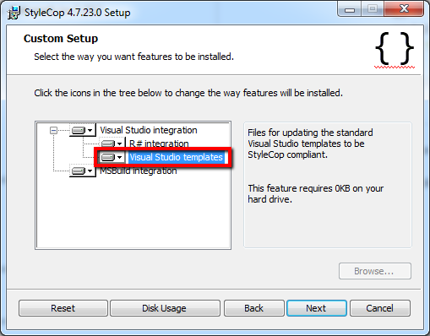
Visual Studio Templates
During the installation
you have the option to install a new set of Visual Studio Templates, which will already by StyleCop “compliant”

Slide 19
Going further with more templates…
Use StyleCop compliant code snippets
http://vssnippets.codeplex.com/
Use StyleCop compliant project/item templates
http://vstemplates.codeplex.com/

Slide 20
Talk to your Team
Get Buy-In from your Team Members
Only enable the StyleCop rules that you want to follow
Have a team meeting to decide

Slide 21
Demo 4
StyleCop Compliance
Using StyleCop Compliant Project/Item Templates and Code Snippets

Slide 22
Extending StyleCop

Slide 23
Add More StyleCop Rules
There are a number of projects that are extending the built-in StyleCop rules:
StyleCop+
http://stylecopplus.codeplex.com/
JSL StyleCop
http://jslstylecop.codeplex.com/
Notes:
StyleCop+ adds
- Advanced Naming Rules
- More Custom Rules
- Code Line Must Not End With Whitespace
- Check Allowed Indentation Characters
- Check Whether Last Code Line is Empty
- Code Line Must Not Be Longer Than…
- Method Must Not Contain More Lines Than…
- Property Must Not Contain More Lines Than…
JSL StyleCop adds
- More Custom Rules
- Members Must be in Alphabetical Order
- Don’t Compare to Boolean Constants
- Local Variable Assignment Unused
- Local Variables Should be Set Where They are Declared
- Move Variable Declaration to Usage Level

Slide 24
Create your own Custom StyleCop Rule
Create a .Net Framework 3.5 Class Library Project in Visual Studio
Add a reference to StyleCop.dll and StyleCop.Csharp.dll
Create your analyzer class that inherits from SourceAnalyzer
Add an XML file with the same name as the analyzer class. Set the properties of the XML file to be an Embedded Resource and not copy to the output directory
Override the AnalyzeDocument method
You are ready to write your own analysis code
http://gep13.me/JIn0xL

Slide 25
StyleCop Contrib
This CodePlex Project started out life as another Custom StyleCop Rule Library, however, now it is a Unit Testing Framework for Custom StyleCop Rules
http://stylecopcontrib.codeplex.com
Allows you to quickly begin testing your Rules, without the need to debug multiple instances of Visual Studio

Slide 26
Demo 5
Extending StyleCop
Create a Custom StyleCop Rule and then test it with Unit Tests

Slide 27
Working with “Legacy” Applications

Slide 28

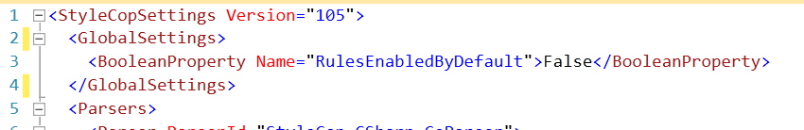
Using StyleCop in an Existing Project
Turn off analysis for generated code
Surround code in a region with the text ‘generated code’ within the title
Turn off StyleCop Analysis for a particular file using SourceFileList in Settings.StyleCop file
Turn off StyleCop Analysis for an entire project using Settings.StyleCop file

Slide 29
Demo 6
Working with “Legacy” Applications
Turning StyleCop off for an existing large project using Settings file

Slide 30
Additional Tooling Support

Slide 31
Refactoring StyleCop Rules
There are plugins available for both CodeRush and ReSharper to help refactor code to be StyleCop Compliant
StyleCop For ReSharper
Now included as part of the core StyleCop installation
Automatically fixes 128 StyleCop issues during ReSharper “CleanUp Code…”
Style Ninja for CodeRush
http://code.google.com/p/dxcorecommunityplugins/wiki/CR_StyleNinja
Fixes 23 StyleCop Issues

Slide 32
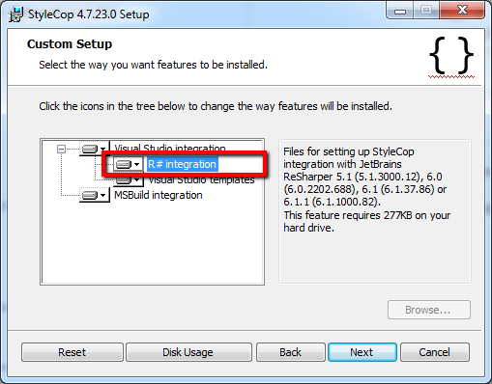
ReSharper Integration
During the installation
you have the option
to install ReSharper
Integration files, these
will be required if you
want to be able to analyse and correct StyleCop warnings using ReSharper Refactorings.

Slide 33
Demo 7
Additional Tooling Support
Using ReSharper to improve StyleCop Compliance

Slide 34
Questions?
Feel free to email me any additional questions at
gep13@gep13.co.uk

